Slide 1

CMS

Slide 2
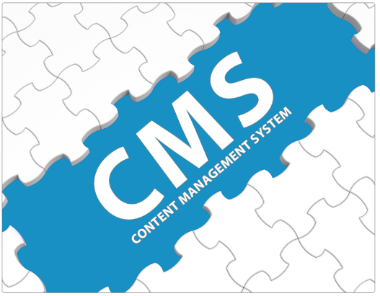

Defining a Content Management System
In order to define a content management system, we need to look at the components the term is made up of……..
What is ‘Content’ ?
What does the ‘Management’ of content refer to ?
What is the ‘System’ that manages the content ?

Slide 3








What is ‘Content’ ?
Content is in essence, any type or 'unit' of digital information.
It can be text, images, graphics, video, sound, documents, records etc.
In other words, it can be anything that is likely to be stored and managed in an electronic format

Slide 4
What does the ‘Management’ of content refer to ?
Because the information being managed is digital in nature – the method of managing is also typically conducted electronically.
The ‘Management’ refers to the process of storing content via rules and process (or a combination of the same) - often with associated workflows - so that the content is deemed to be ‘managed’ rather than ‘unmanaged’ where it is located.

Slide 5
Management
Authoring
Approval/Publishing
Content Classification and Categorization
Collaboration and Workflows
Tagging and Associating Metadata
Content reuse
Versioning and History
Monitoring
User and Access Management
Roles and Permission
Notes:
Content Classification and Categorization – Taxonomy (Car-> SUV, Sedan, Hatchback)
Metadata - set of fields and values used to describe and categorize content and managed objects. Users will often want to search for key data associated with a file such as an Author, Date Published, Key Words, Topic and so on.
Content reuse - Webparts
Monitoring - Audit Logs

Slide 6
What is the ‘System’ that manages the content ?
The ‘System’ itself is definable as a software tool, or combination of software tools, that facilitate the efficient and effective management of the content so as to achieve the desired 'output‘ (which can be electronic or hardcopy).

Slide 7
System
Content and Page Editors
Template/Layout Builder
Graphical Workflow Builder
History
User, Roles and Permission
Content Synchronization
Multichannel publishing
Content Translation and Multilanguage Support
Digital Asset Manager
Document Management
Notes:
Multichannel publishing - delivering a publication to your readers in many ways at the same time.
Some people might read your content in a book or a manual, while others might read your content on mobile phones, tablet computers, or Web sites. Visually impaired people might have access to your content through Braille or voice translation devices. Therefore, you need to publish your content in multiple ways through print and digital publishing methods to reach all of these readers.
DAM - System organizes content such as documents, pictures and videos, but in the form of media files. When CMS and DAM are integrated, the media library of the CMS is usually replaced by an Asset Browser that accesses content directly from the DAM system.

Slide 8
What is a ‘Content Management System’ ?
Combining all three definitions we get the following;
A CMS is a software tool that enables groups of technical and non technical staff to store, create, edit, manage and publish a variety of digital content types to an intended audience, whilst being constrained during the content process by a centralised set of rules, process and workflows that ensure coherent, validated and managed electronic content is produced.

Slide 9
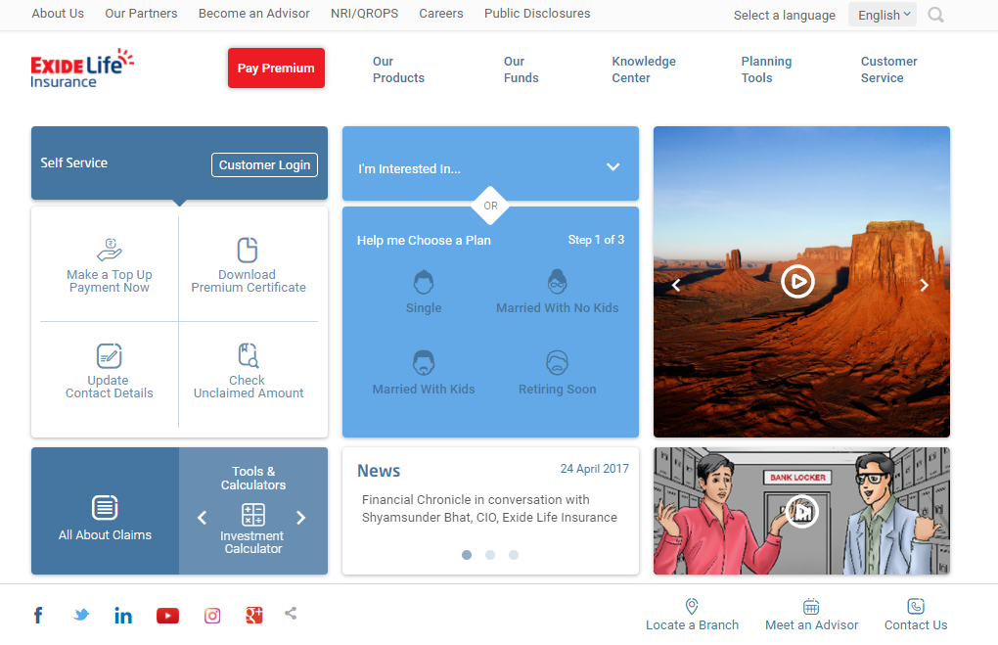
Sample CMS Portal

Slide 10
CMS Workflow
1. Edit Web site properties
2. Preview a site
3. If administrator, set the
access rights for different
users
Login in the CMS
Choose a website
from the weblist
Choose a predefined
workflow
OR
Create a new workflow
Changing the order
of sections
OR
Changing the properties
of a section
Adding new pages in a
Section of a web site
after creating the
index page
Create sections for
adding new content
in the site
Display the content
on the screen
Upload media files on
the Web server
Choose a predefined
template
OR
create a new template
Notes:
Workflow is the series of activities that are necessary to complete a task.
Each step in a workflow has a specific step before it and a specific step after it, with the exception of the first step.

Slide 11
So how come there are so many CMS solutions ?
Given that there are many different types of digital content.…..it follows that there are many different types of CMS (some crossing over from one type to another) – these are the most common examples;
Web Content Management
Document Management
Records Management
Digital Asset Management
Portal Content Management
Enterprise Content Management (all of the above)
Notes:
Web content management system (WCMS)^{[1]} is a software system that provides website authoring, collaboration, and administration tools designed to allow users with little knowledge of web programming languages or markup languages to create and manage website content with relative ease.
Document Management involves the day-to-day capture, storage, modification and sharing of physical and/or digital files within an organization.
Records management establishes policies and standards for maintaining diverse types of records. Some, but not all, documents within an organization become records.
Retention period - Number of years prescribed by a law for which certain records must be kept before their final disposition.
Portal Content Management – is a framework for aggregating and integrating information, people and processes across an organization. As an example, when we think of an intranet portal, we might think about how to provide self-service access to our human resource and payroll system, which allows a user to update their benefit information and submit changes to their payroll tax withholding. At the same time, we need to display content such as a policy or help on the page. So our main focus is to surface and integrate those applications, but we also want to include some placeholders for content. https://india.gov.in/

Slide 12
Why do we need a CMS ?
Content of a website is rarely static
Content get stale; update your website on your own terms
No HTML knowledge? No problem!
Redesigning the website won’t require a complete site overhaul
The enterprise organizations need much more than a mere website
Manage entire internet marketing strategy under one roof

Slide 13
How CMS fits into an enterprise?
Marketing Website
Reflects the internet marketing strategy
Source of Lead Generation
Customer Engagement and Retention
Microsites
Small websites for a specific reason and duration
Multi Sites
Different brands under a single parent company
Multiple front end websites with a single content management interface
Intranet Portal
Various Services under one umbrella
Internal Communications

Slide 14
A few popular CMSs
Proprietary
Open Source
EPiServer
Ektron
Sitecore
Sitefinity
Kentico
SharePoint
WordPress
Drupal
Joomla
OpenCMS
DNN

Slide 15
What do developers do with CMS ?
Make CMS meaningful for the marketing and business
Defines the information architecture – where to put (and later find) what ?
Build the presentation layer – the website

Slide 16
Information Architecture
Website Structure
Content Categorization and Classification
Content Structuring
Content Modularity
Asset Structuring
Document Repository
External Content Access
Notes:
Website Structure – Masterpages
Content Categorization and Classification – Taxonomy
Content Structuring – Page layouts/Templates
Content Modularity - modular content allows you to add any content text or media in blocks and can be arranged and sorted easily.
Asset structuring - The asset management system offers the possibility to manage any type of media such as images, text-based documents (e.g. Word, Excel etc.), videos or any other data into Folders. Choose between a list view or large and small thumbnails

Slide 17
Presentation Framework
Web Application
Architecture
Templates/Page-Types
Blocks/Modules/Widgets
Content Rendering
Multilingual
Responsive / Mobile Friendly

Slide 18
SEO
Page Titles, Meta Data, Keywords
Customizable
Navigation Menus
CSS Based
URL Structure
Keyword based (http://www.domain.com/keyword1/keyword2/index.html)
Support for the canonical Tag
Set preferred URL (rel=“canonical”)
XML Sitemap Creation
Automated sitemap
Redirects
301 Redirect
Notes:
Search Engine Optimisation or SEO is the simple activity of ensuring a website can be found in search engines for words and phrases relevant to what the site is offering. Search engine optimization is a methodology of strategies, techniques and tactics used to increase the amount of visitors to a website by obtaining a high-ranking placement in the search results page of a search engine (SERP) — including Google, Bing, Yahoo and other search engines.
https://searchenginewatch.com/sew/how-to/2223883/10-seo-considerations-for-a-content-management-system
If you're moving a website from one URL to another, you need to take the necessary steps to ensure your visitors get sent to the right place. In the world of tech, this is called a 301 redirect.
A 301 redirect is key to maintaining a website's domain authority and search rankings when the site's URL is changed for any reason. It easily sends visitors and search engines to a different URL than the one they originally requested -- without having to actually type in a different URL.

Slide 19
Deployment Architecture
On Premise
Cloud
Hybrid

Slide 20
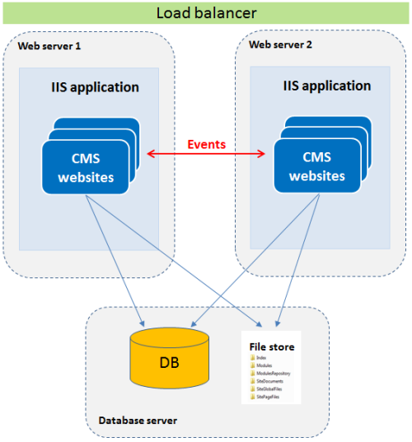
On Premise
Notes:
This is an example of a CMS website running on IIS. Load-balancing manages multiple CMS sites that run on two or more separate web servers that run IIS. All the sites share the same database and file store.
You can load-balance Episerver CMS across multiple servers using the Episerver event management system. When an event occurs, such as a cache removal notification, that server updates the local cache and configured servers in the setup.

Slide 21
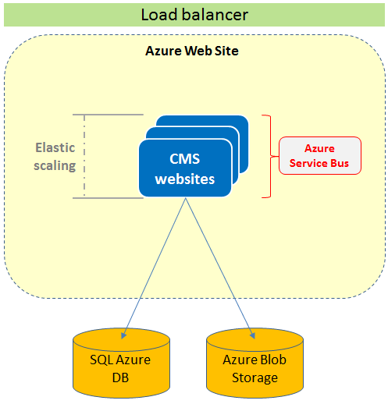
Cloud
Notes:
This is an example of a CMS website running on Azure Web Site environment with multiple instances. The website instances share the same Azure SQL database, and the blob storage in Azure is used for storing of the file binary data. Load balancing is applied, and the Azure Service Bus manages events between the CMS websites. Using elastic scaling, the number of CMS sites can easily be increased or reduced depending on capacity needs at the time, from the Azure administration interface.

Slide 22
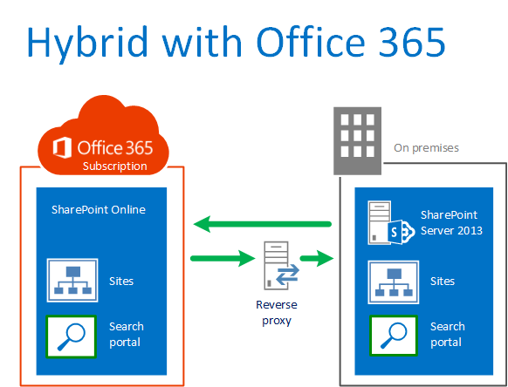
Hybrid
Notes:
Reverse proxy is a type of proxy server that retrieves resources on behalf of a client from one or more servers. These resources are then returned to the client like they originated from the Web server itself.
Search - Being able to search across both environments
BCS - Being able to access data in on-premises applications/systems from Office 365

Slide 23
Thank You…

